Slide 1
Movie Recommendation
Submitted by : Aman Jain

Slide 2
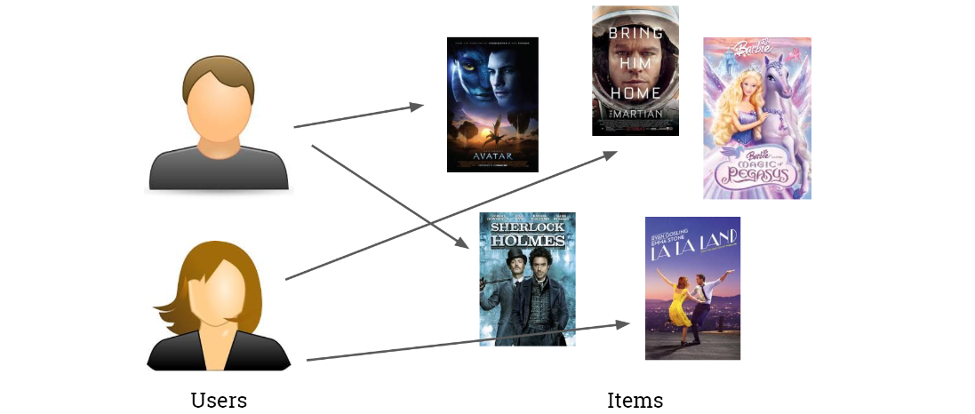
Recommendation Systems

Slide 3
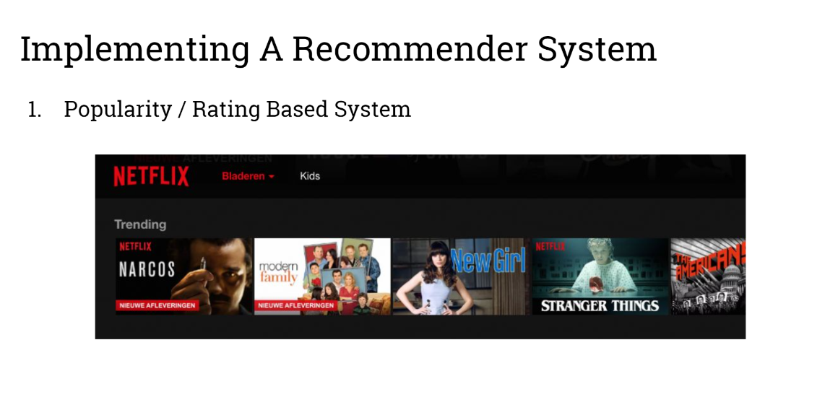

Slide 4
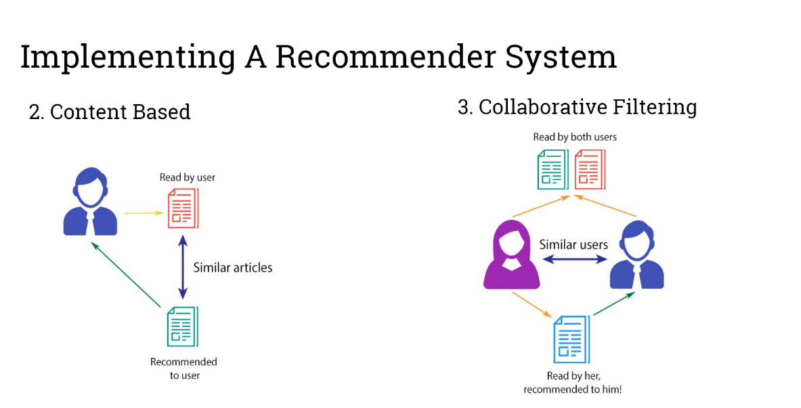

Slide 5
Similarity between content
Text A: Bms Bms College
Text B: Bms College College

Slide 6
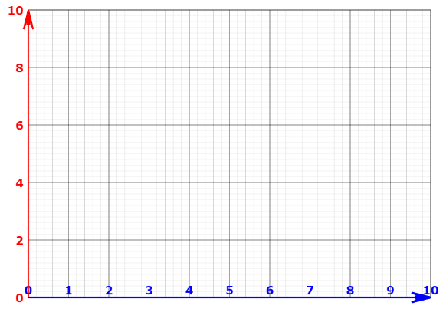
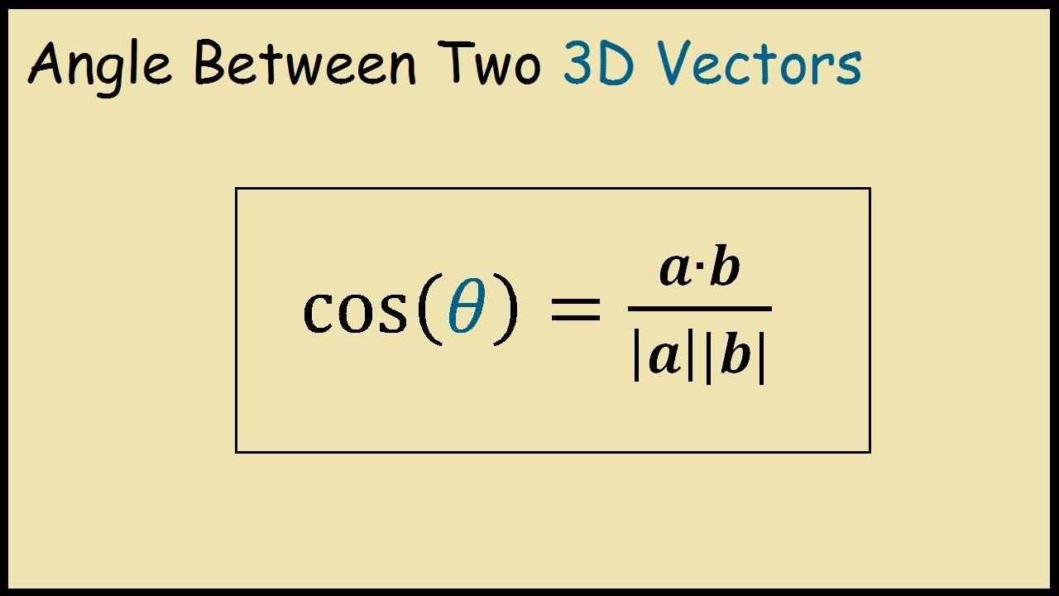
Distance between two vectors
Text A : Bms Bms College (College: 1, Bms: 2)
Text B: Bms College College (College: 2,Bms: 1)
Bms
(1,2)
(2,1)
College

Slide 7
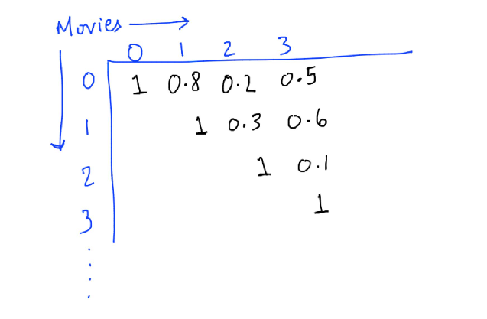
Understand the similarity matrix

Slide 8
